Slide 1
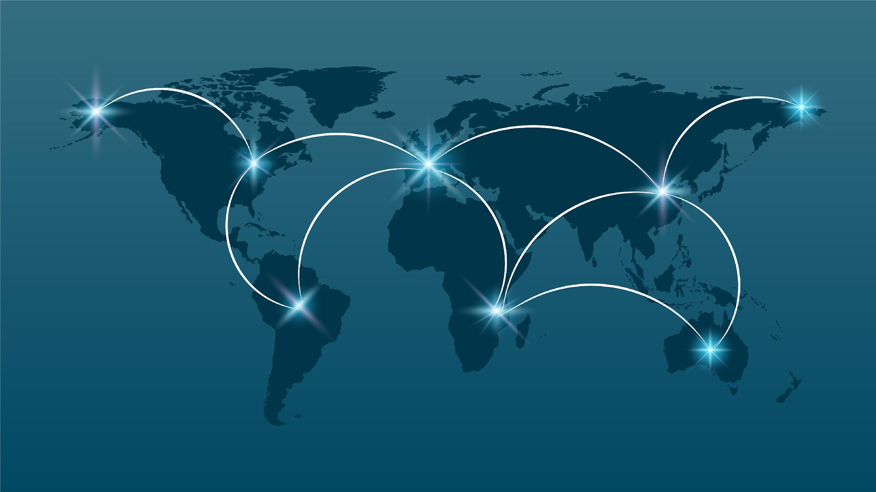
Visualising World Connectivity
Project Team Members: Khadra, Chisimnulia, Kudzanai and Nathaniel

Slide 2
Table of Contents
Introduction
Data Extraction and Transformation
Data Loading
Data Visualisation
Data Exploration
The Dashboard
Technologies Used

Slide 3



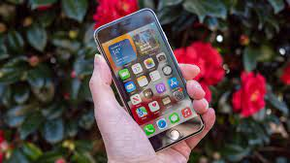
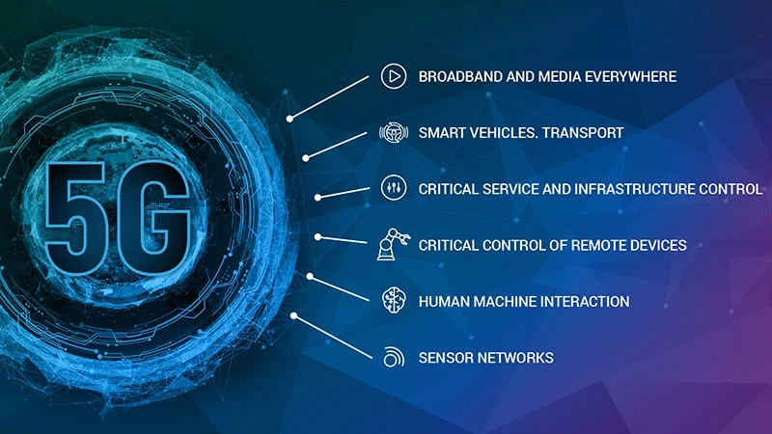
Introduction
Does anyone feel certain nostalgia looking at these images. Remembering for example the box phone ringing and waking up the entire neighbourhood.
Now we are here; the era of 5G internet and smartphones.
This presentation hopes to take you on a journey through the years showing you where we were, where we are and perhaps where we are headed.

Slide 4
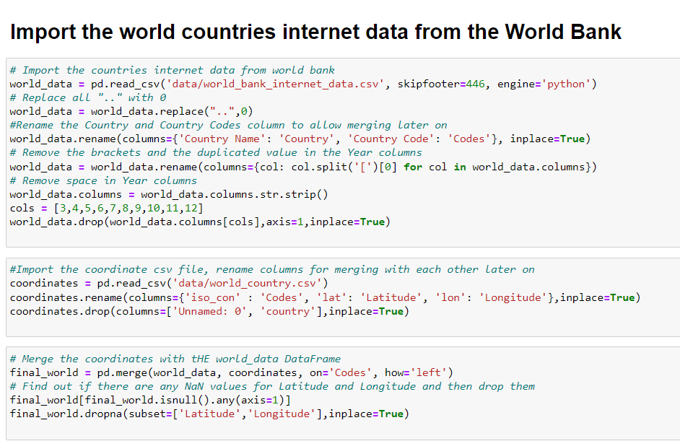
Data Extraction and Transformation
The right data to visualise this project would be one covering very long time periods. We found two large datasets from two different sources: World Bank and ITU, and Countries Location dataset on Kaggle.
We then transformed the extracted csv and excel files with Python using Pandas Jupyter notebook.
See cleaning_data.ipynb for details of all data extraction and transformation done

Slide 5
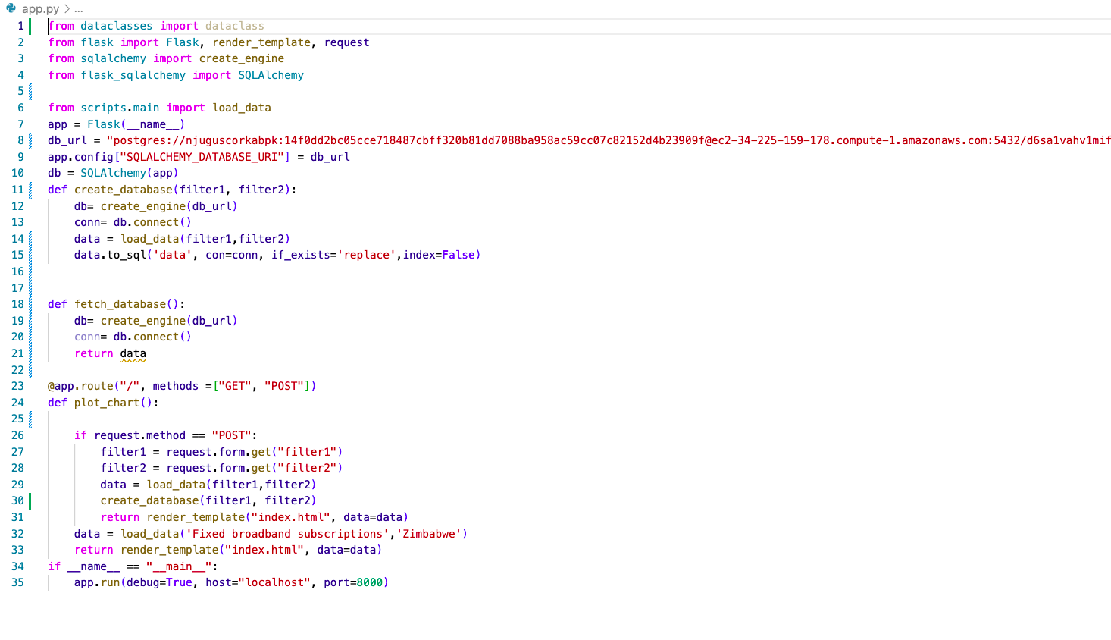
Data Loading
Our data is housed in an NonSQL database, MongoDB, using a Python Flask-powered API:
To automatically fetch data and render the template.

Slide 6
Data Visualisations
Finally to visualise this data we built an interactive dashboard using the PLOTLY and HIGHCHARTS libraries.
Some other features of our dashboard include:
Five interactive charts
User driven interactions such as dropdowns, zoom features, menu bars, image download etc
Year slider button
Hover

Slide 7
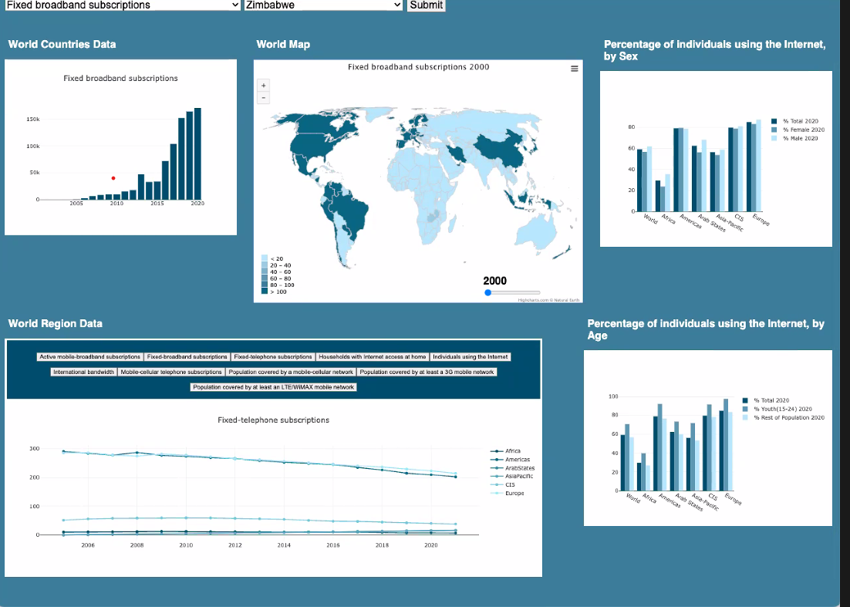
Data Visualisations

Slide 8
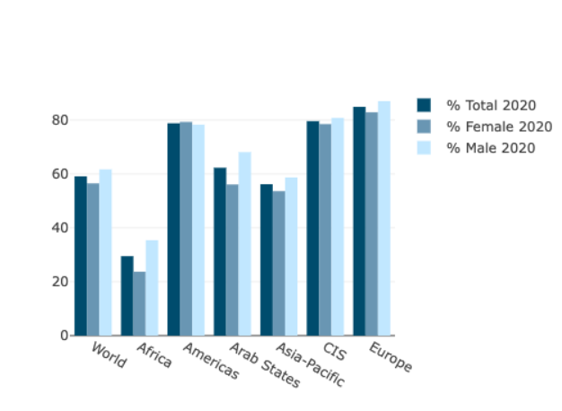
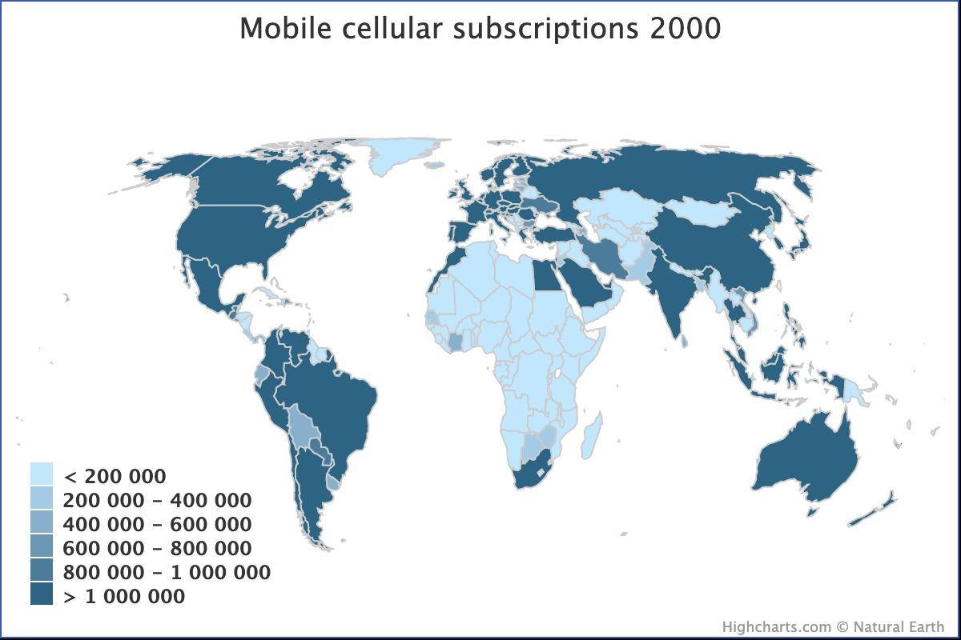
Data Exploration
Across the globe, what gender would you say has more access to the internet?
Did you know that in the year 2000, most African countries less thank 200,000 people connected to the internet.

Slide 9
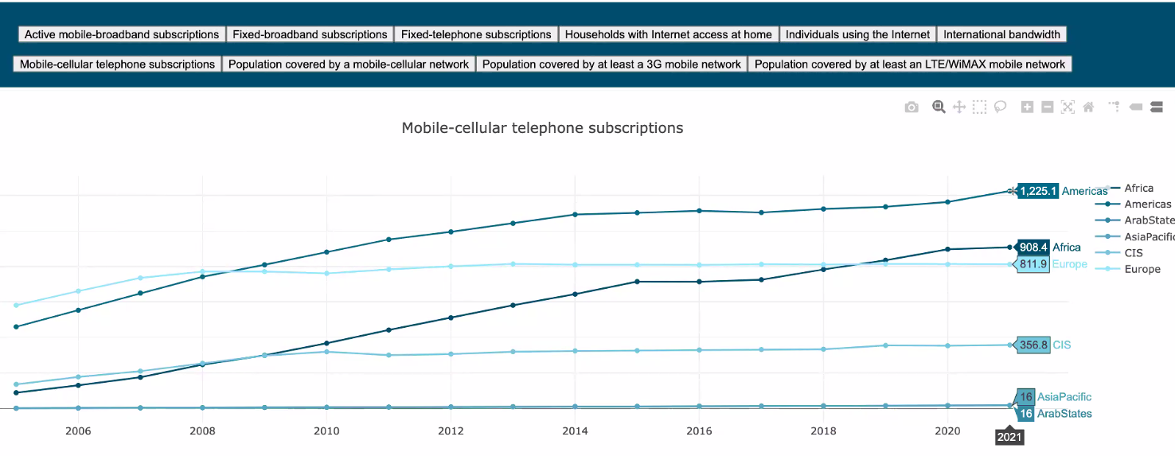
Data Exploration
Did you know that Africa is currently the second leading continent with mobile-cellular telephone subscriptions?

Slide 10
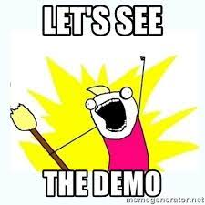
Connectivity Dashboard

Slide 11
Technologies Used
Database
pgAdmin/SQL-Postgres connected using Heroku
Python Flask-powered API
To automatically fetch data and render the template
Python using Pandas Jupyter Notebook
To clean the data for the data cleaning function we used to load our data
HTML / CSS
For the index.html layout and to render our charts
JavaScript
for plotting the interactive charts
JS Libraries
Highcharts – Useful for complex chart types with fully fledged customisations for the world map
Plotly.js - Open Source Graphing Libraries for the charts

Slide 12
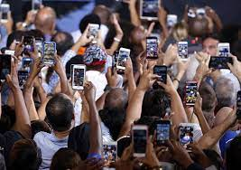
Any questions?

Slide 13

Thank
you!

